Slide 1

An internship Final defense on
Wind Horse Tours
Submitted by
Urgen Sherpa
T.U. Exam Roll No. 3328/070
Submitted to
Department of CSIT,
Sagarmatha college of science and Technology

Slide 2


Slide 3

Halftone designs pvt. Ltd.
Provide services regarding graphic design, website designing, development and maintenance.

Slide 4

Wind horse tours
Tours, treks and travel operating company.

Slide 5

Problem Statement
Outdated design.
Lack of responsive theming.

Slide 6

Project Objectives
To update the designs of the web application according to the latest trends.
To implement responsive theming.

Slide 7
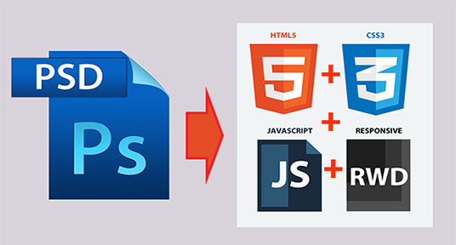
Psd to html conversion

Slide 8
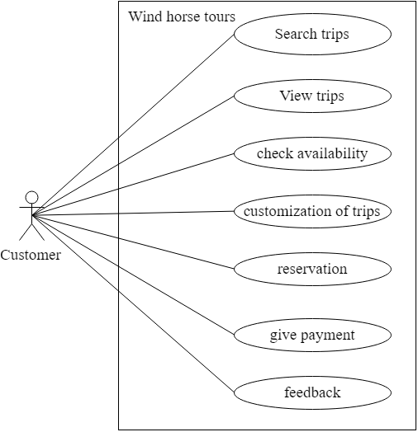
Use-case diagram (customer)

Slide 9
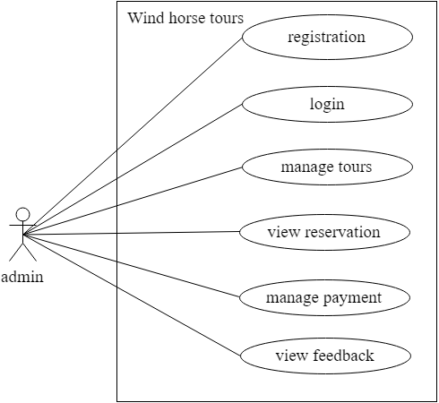
Use-case diagram (admin)

Slide 10
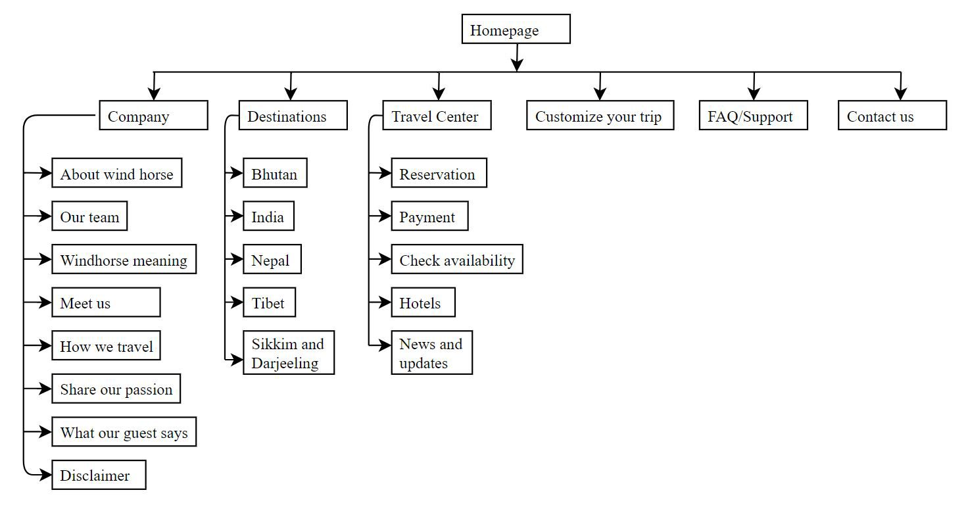
WEBSITE STRUCTURE

Slide 11
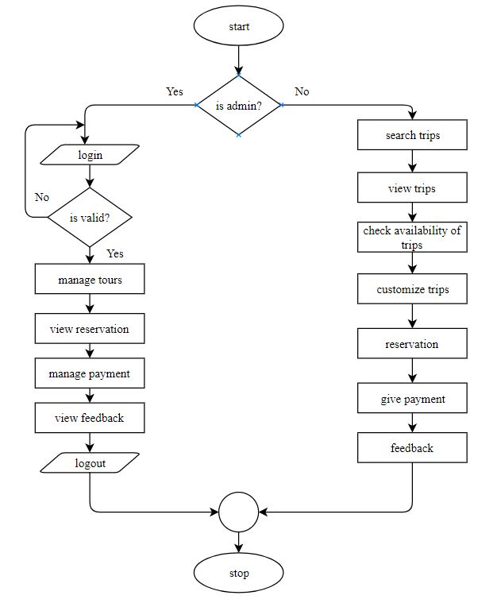
Flowchart of the application

Slide 12





FROnt-end technologies
Photoshop cc 2017
Sublime Text 3
Html5
Css3
JavaScript/Jquery

Slide 13




Back-end technologies
PHP
MySQL
Apache
InMotion Hosting

Slide 14

Testing
Code validation
Cross-browser compatibility testing
Responsive Design testing

Slide 15

Code validation
Html5 validation: https://validator.w3.org/

Slide 16

Code validation
CSS validation: https://jigsaw.w3.org/css-validator/

Slide 17

Cross browser testing

Slide 18

Responsive design test
Google Chrome’s Devtools feature: device mode

Slide 19
conclusion
Conversion of PSD template of wind horse tours to html5/css3 is completed.
Responsive design has been implemented.
Code validation, cross browser testing is completed.

Slide 20
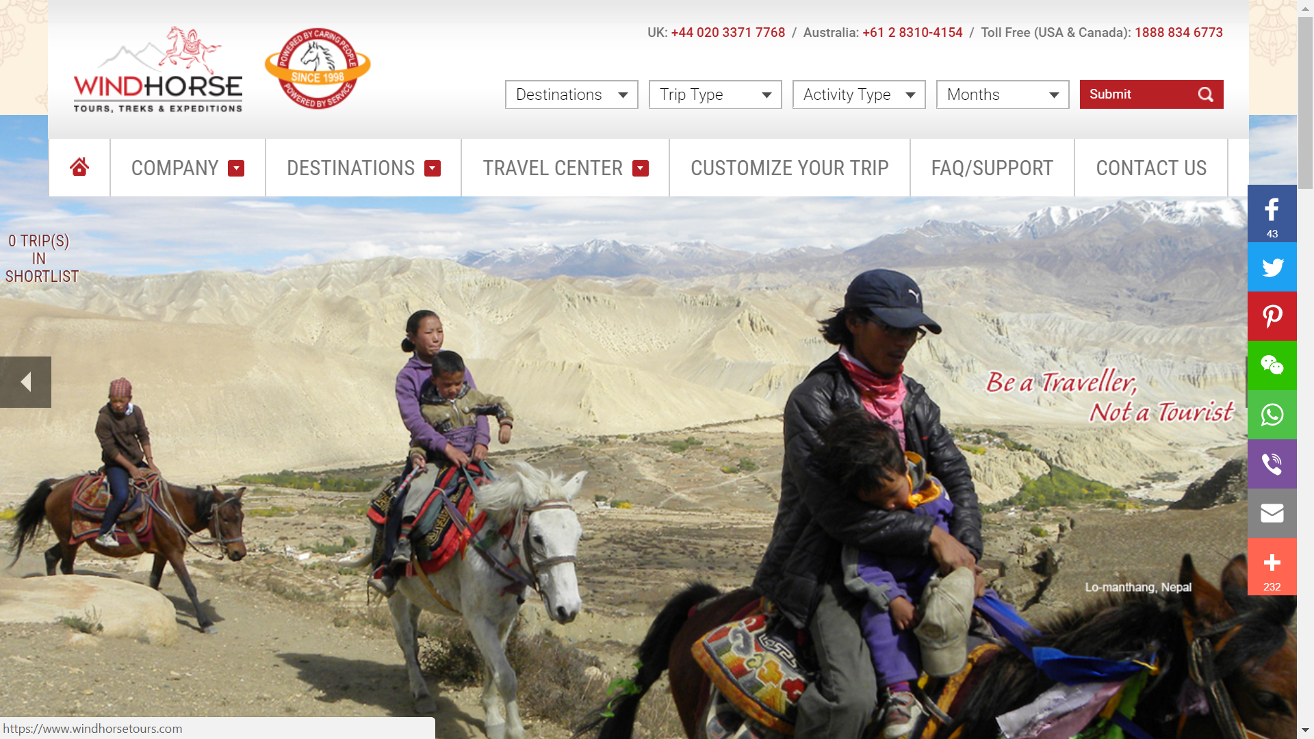

Slide 21
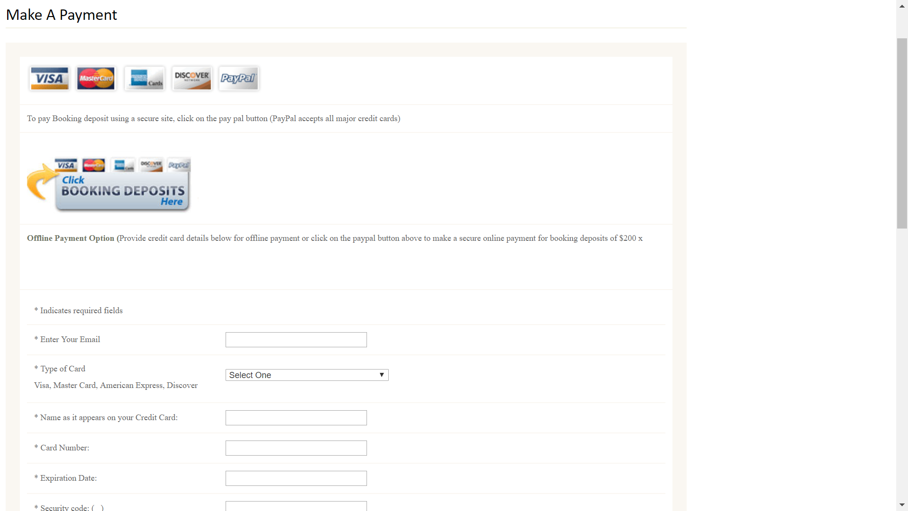

Slide 22
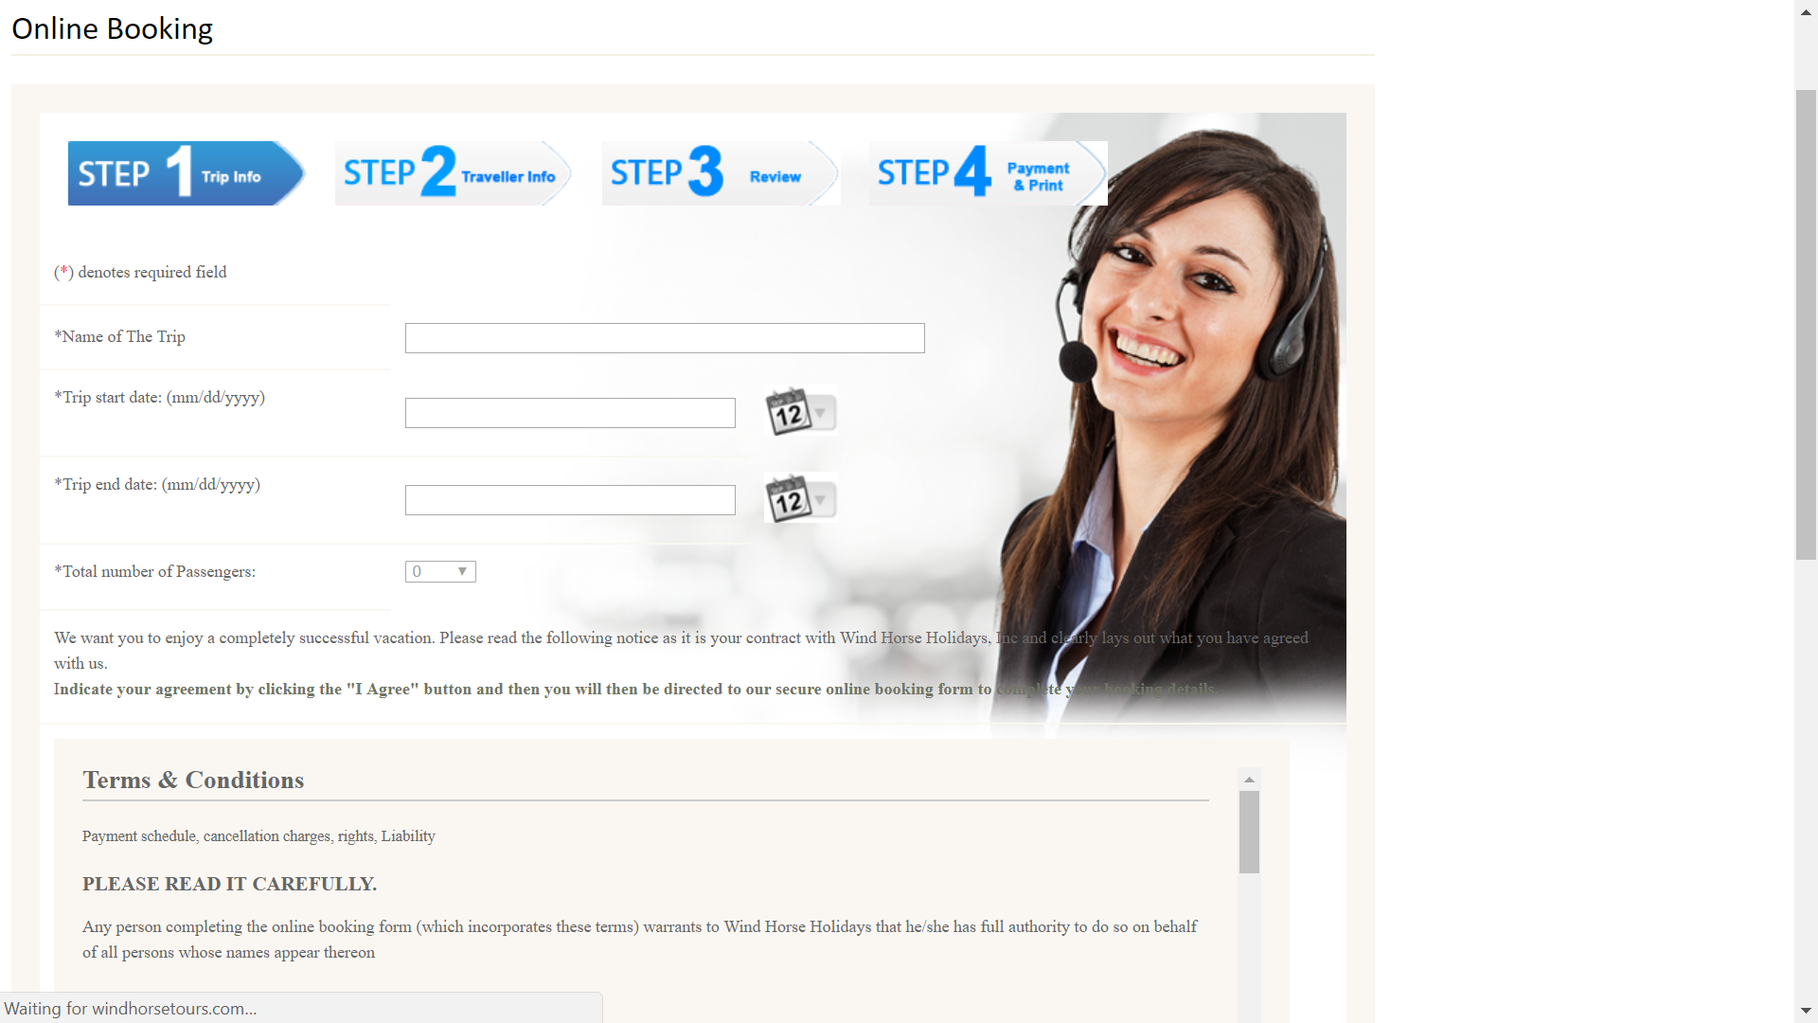

Slide 23
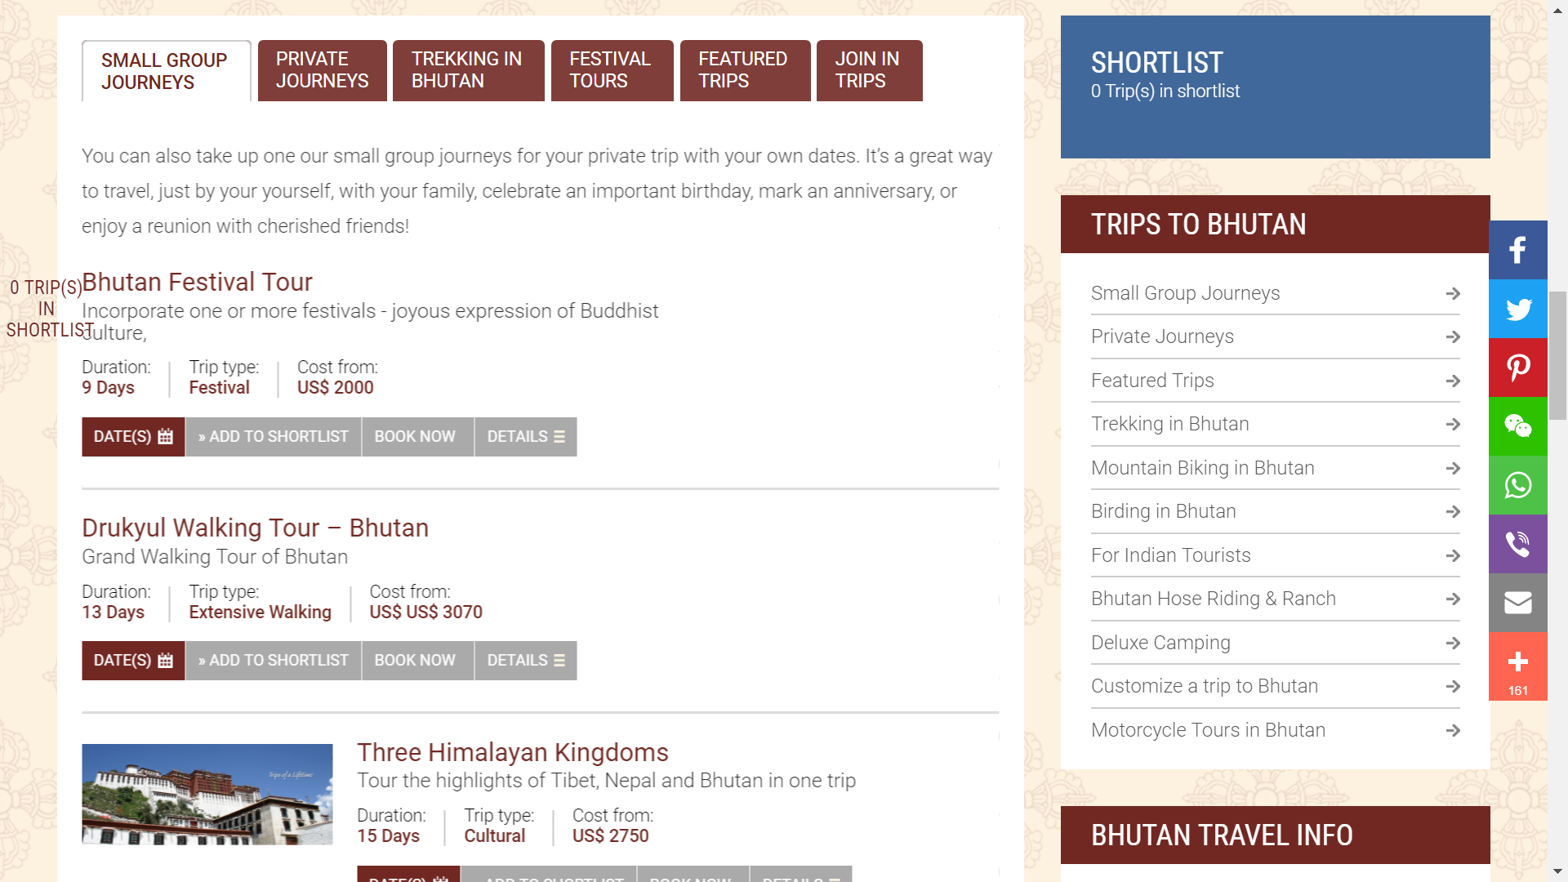

Slide 24
Thank you!!

